Slide 1
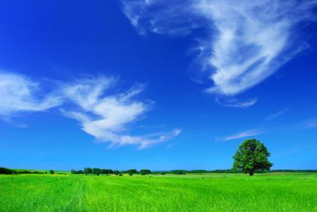
Preserving Our Planet for the Grandchildren and All Life

Slide 2
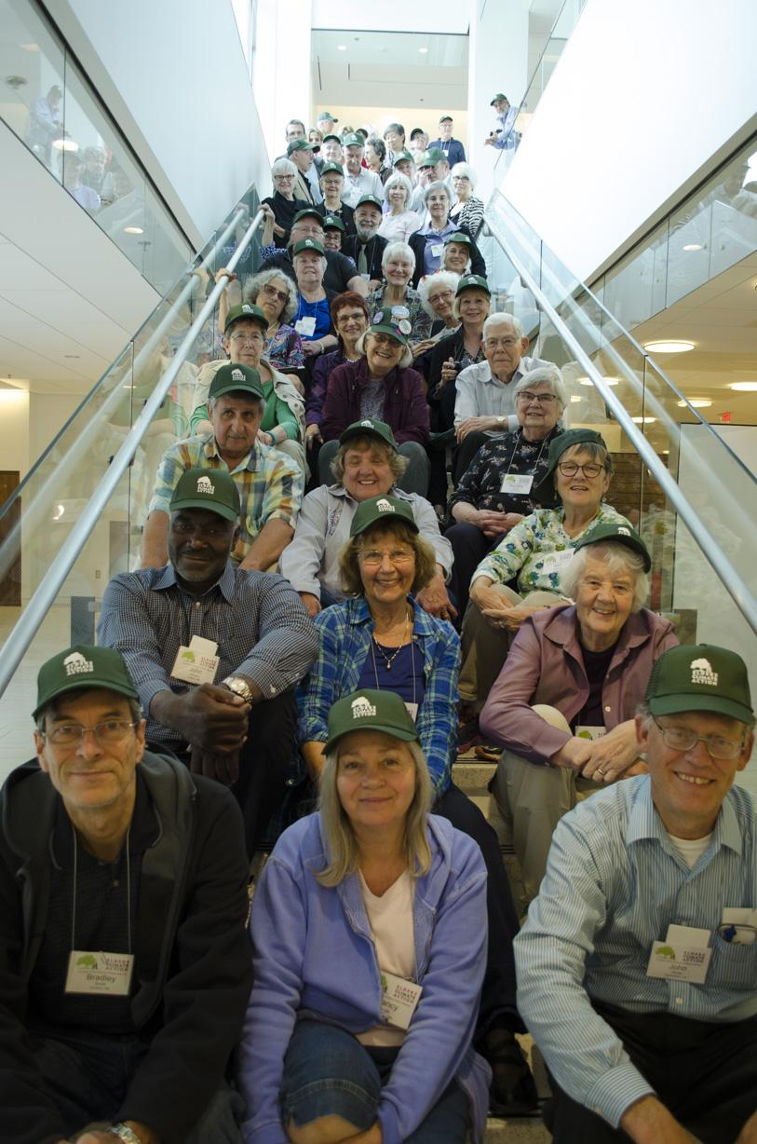
Who We Are
Elders Climate Action mobilizes elders throughout the United States to address climate change while there is still time to protect the wellbeing of our grandchildren,
future generations and all life.

Slide 3
Our Mission
We are dedicated to using the power of our caring, our wisdom and our numbers to push for strong energy policies that will reduce greenhouse gases in our atmosphere to a level consistent with life thriving on our planet.

Slide 4
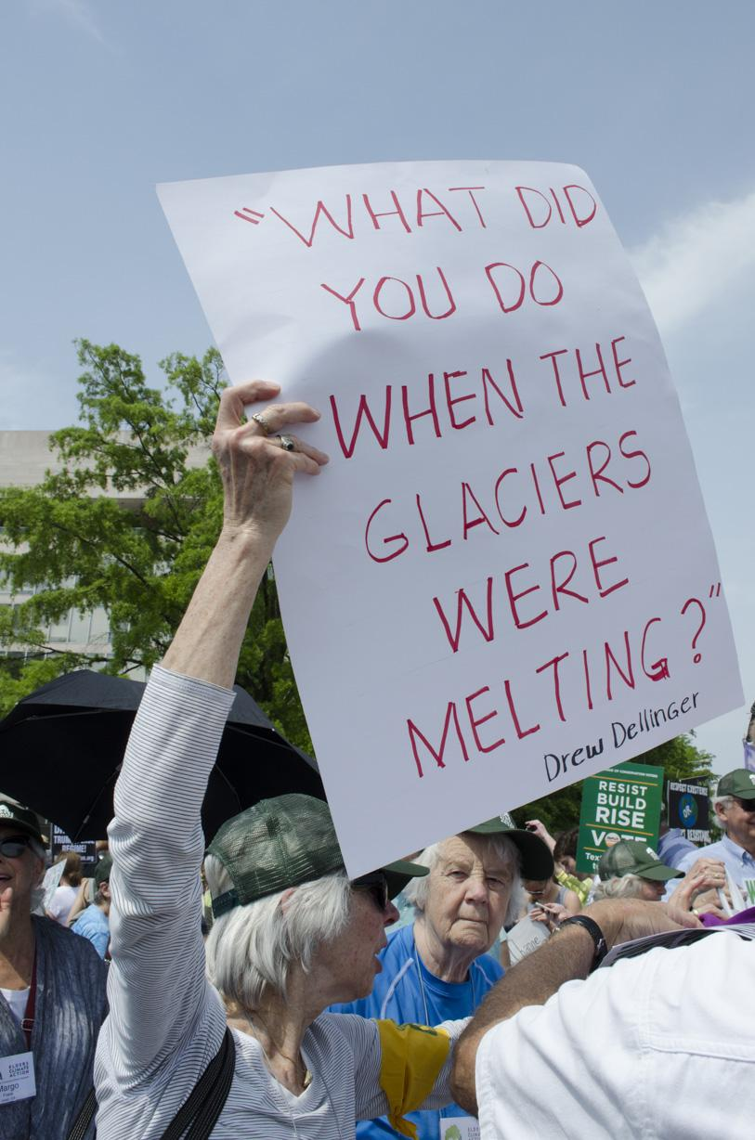
A Closer Look
We are a young organization – launched in 2014
A campaign of Conscious Elders Network, a not for profit and non partisan organization
All Elder volunteers
3500 members, represented in all 50 states
Four local ECA Climate Action Teams organized as chapters with more to come
We currently have 62 partner organizations

Slide 5
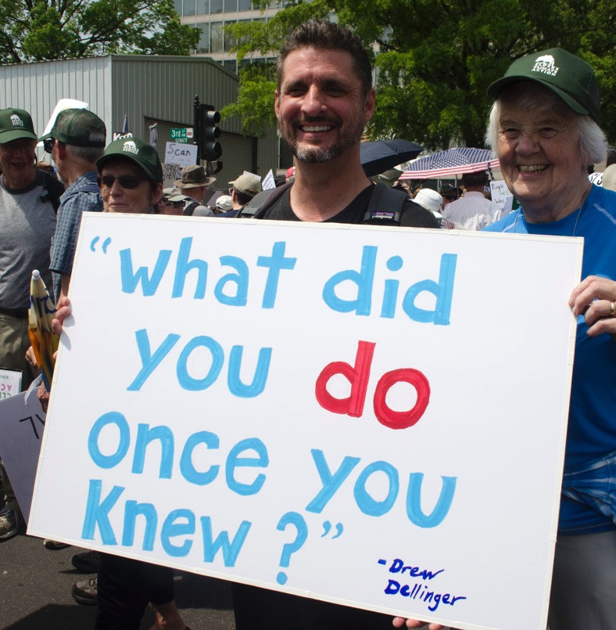
Did You Know?
Baby Boomers are the largest voting bloc in the United States. Making up 32% of registered voters, an estimated
80 million elders!

Slide 6
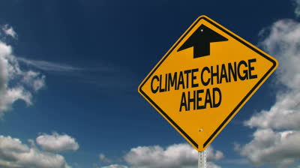
Our Core Initiatives
Carbon Fee and Dividend legislation
EPA emissions regulations
State and local policies
Fossil fuel divestment

Slide 7
Building a movement at local, state and national levels
A non-partisan community of engaged elders
Developing partnerships with a broad spectrum of other organizations
Have fun and develop new connections as we work together
We have many volunteer opportunities waiting for you
Together We Will Make Our Voices Heard!

Slide 8
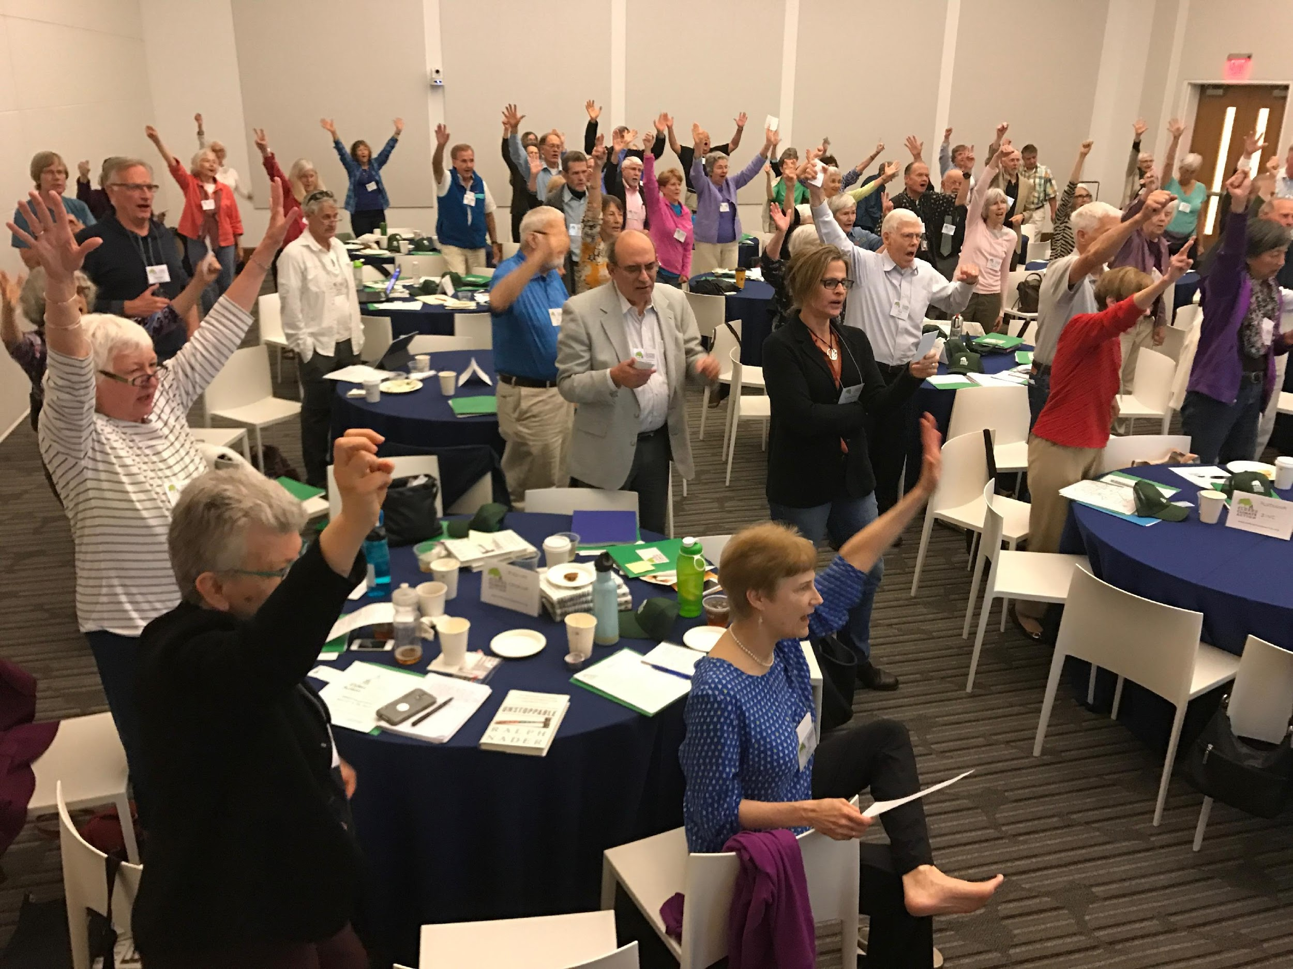
The Voices Of Elders Matter!

Slide 9
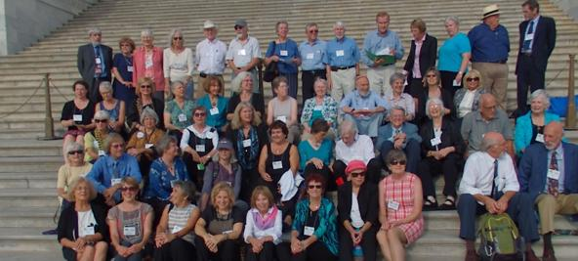
Coming Together As Elders
Grandparents Climate Action Day 2015
A gathering of elders in Washington for a day of inspiration and education, and a day of meetings with 44 Members of Congress
The first ever ECA Flash Mob with Elders in Union Station and a Congressional Dining Room ECA Flash Mob

Slide 10
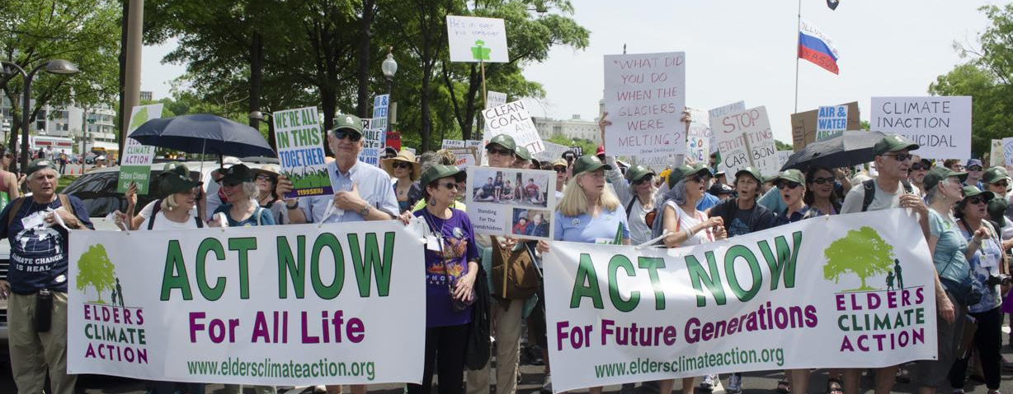
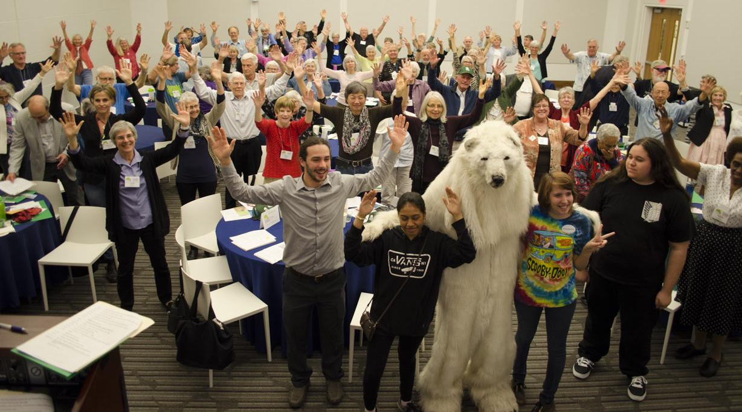
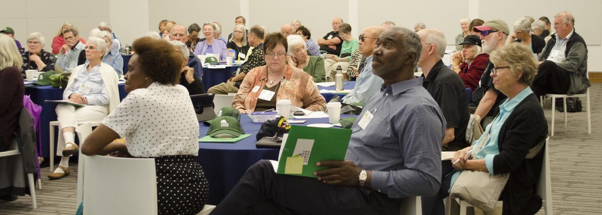
Elders Climate Action Day 2017
Elders joined together in Washington D.C. for a day of education and inspiration, a day of lobbying, and a day of marching!
We delivered our Climate Pledge to all 535 members of Congress. Watch Slideshow Now
We marched with an estimated 250,000 people in the People’s Climate March.

Slide 11
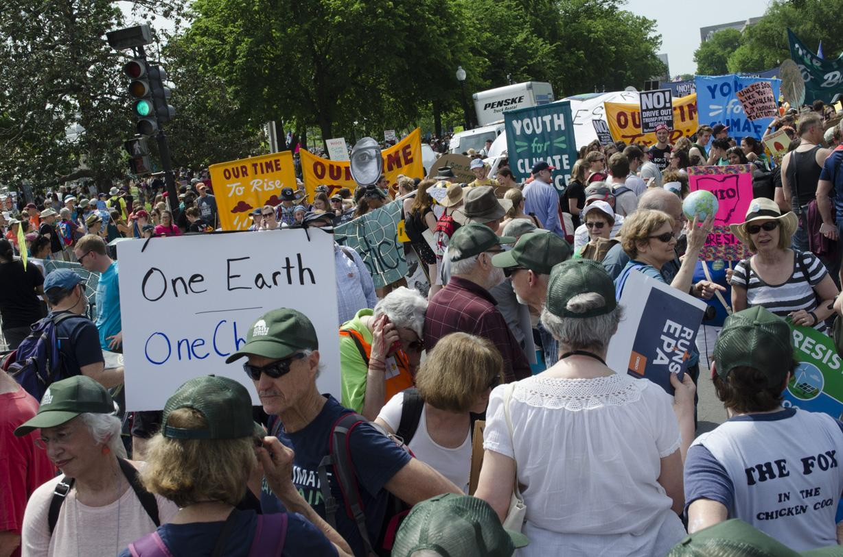
ECA In Action: Slideshow from the People’s Climate March

Slide 12
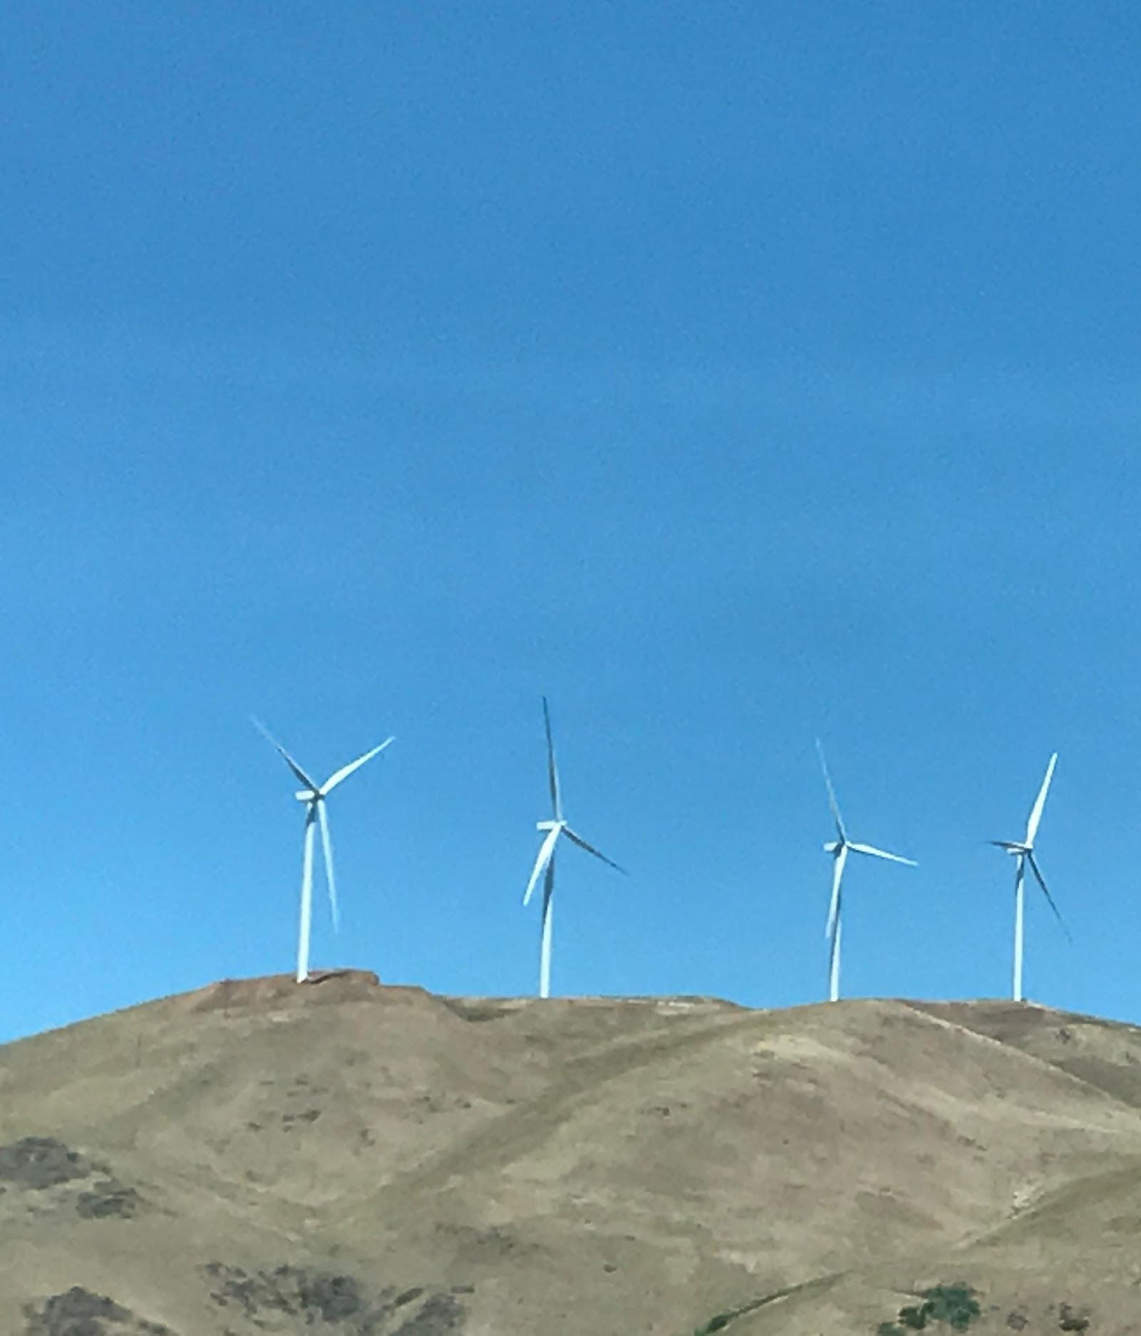
ECA Takes Action
Congressional Candidates Climate Project 2016
Elders Climate Voter Pledge 2016
Stop Pruitt’s Nomination to the EPA Campaign
Monthly Newsletter
Monthly National and Volunteer Calls

Slide 13
How We Elders Engage
Chapters
An organized group in a specific geographic area
Collaborations
Specific initiatives with another organization
Teams
Small group identifies a project
National Committees
Participate in an ECA leadership committee

Slide 14
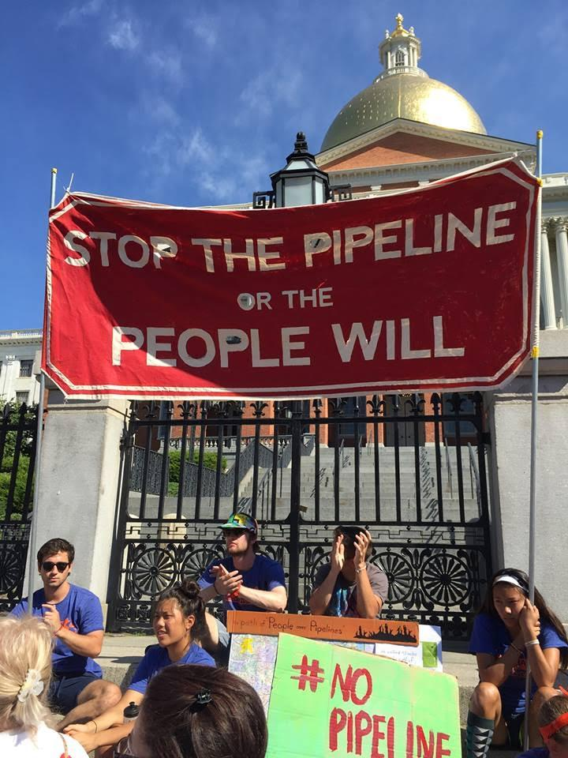
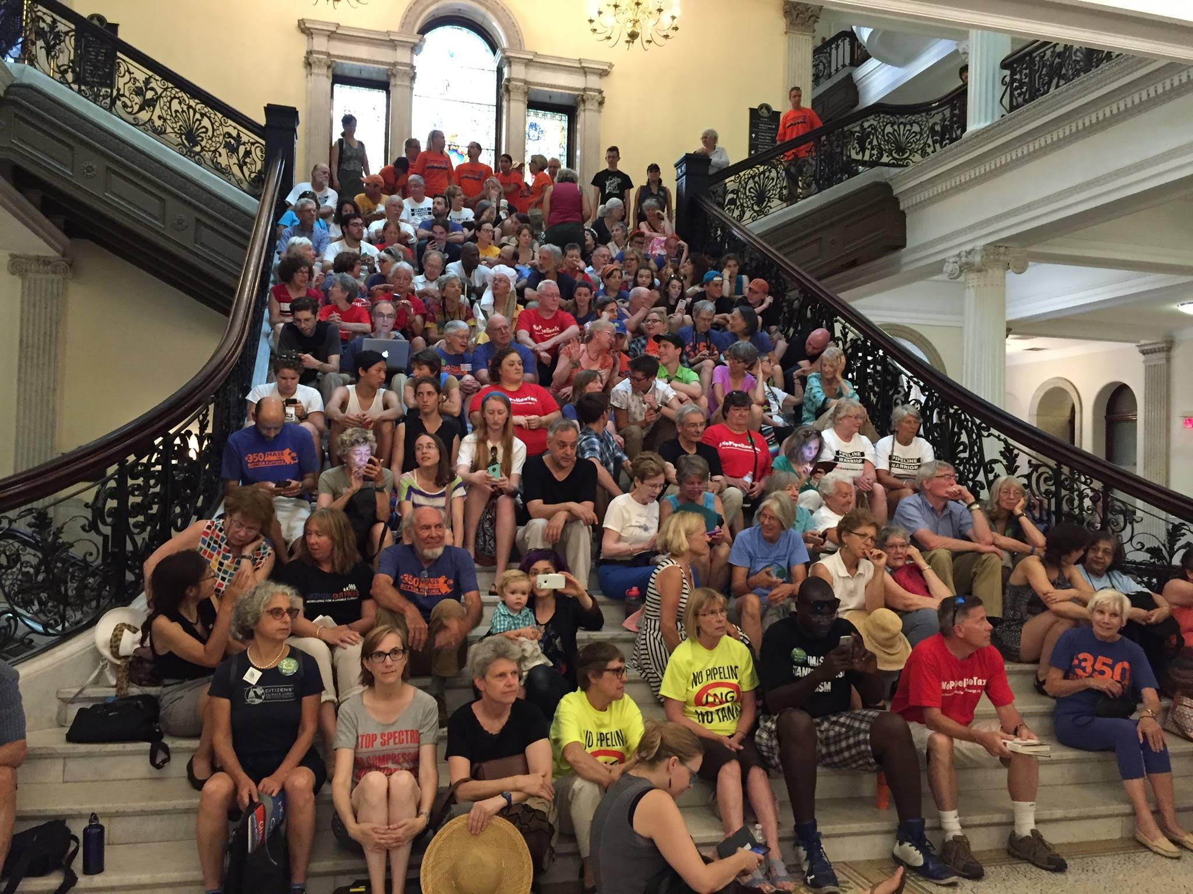
ECA Local Chapters
Massachusetts Chapter
A Local Climate Action Team
Formed in early 2016 with statewide membership
Alliances with other environmental groups
State legislation on an energy bill
Presentations to groups of elders
Communications with members
Participates in local efforts
massinfo@eldersclimateaction.org
Ann Arbor, MI Chapter
The Ann Arbor Area chapter was approved early in 2017. We mix both activist and educational activities with opportunities to socialize in order to build a strong community. Our primary focus is local issues, working in conjunction with partner climate organizations to avoid reinventing the wheel.
annarbor@eldersclimateaction.org

Slide 15
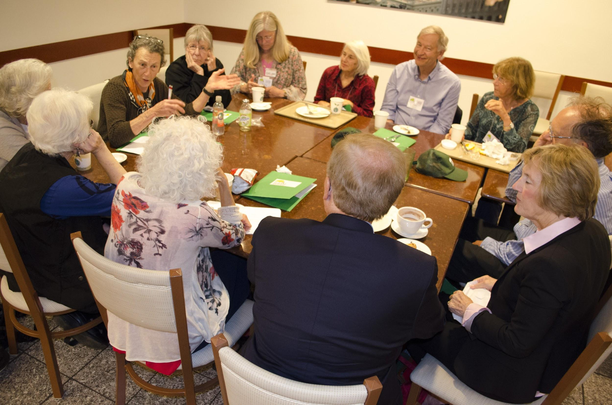
New Local Chapters
Northern California
(NorCal Chapter)
Inspired by ECAD 2017
Newly formed in the summer of 2017.
Covers large geographic area including the Bay Area, rural Northern California and Central valley communities.
Interested in local action, statewide and regional policy, outreach to senior communities and collaborating with partners
norcal@eldersclimateaction.org
Maryland Chapter
Since May, a group of elders have met five times, have submitted an application to become an ECA chapter, are working to oppose the construction of a natural gas pipeline across the Potomac River, and are exploring ways to work with ECA partners on a variety of local, state and national initiatives to address climate change.
maryland@eldersclimateaction.org
Start a Chapter
in Your Area!

Slide 16
Leave a Legacy of Change
United we have the power to
Change energy policies
Reduce greenhouse gases
Create a planet where life continues to thrive

Slide 17
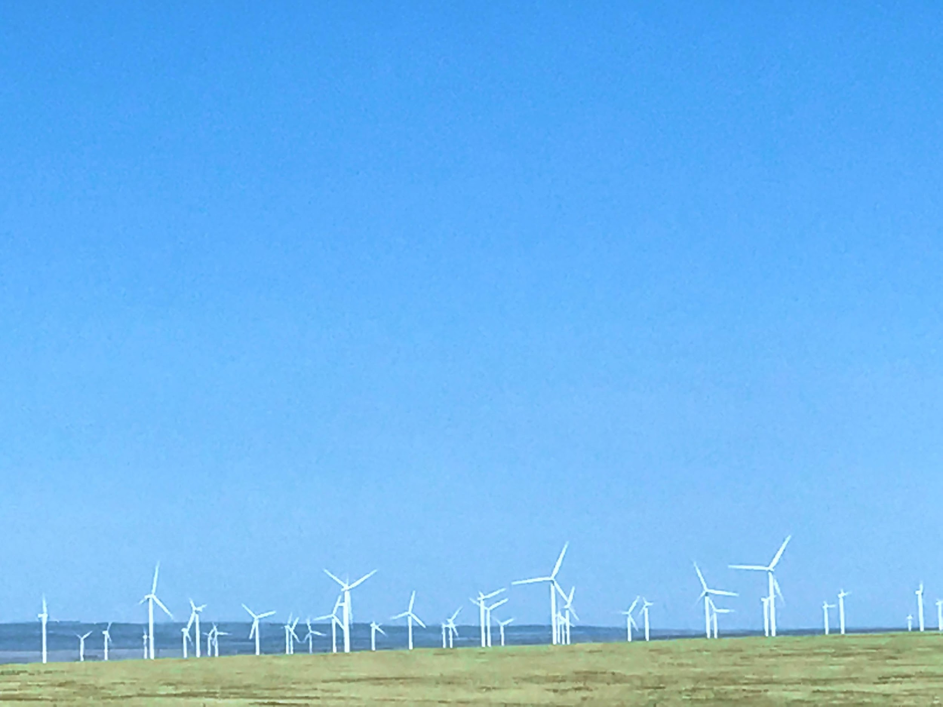
Take Action Now
for your grandchildren, future generations and all life.
10 Simple Ways to Participate
1. Organize a 2-3 member ECA team in your Congressional district or local community and schedule meetings with your Representatives
2. Send a letter to your Representatives. Visit our Website to send a letter today!
3. Join or Start a Local Chapter in your Area
4. Represent Elders Climate Action at Local/National Events
5. Like, Follow, Post and Share ECA on Facebook & Twitter

Slide 18
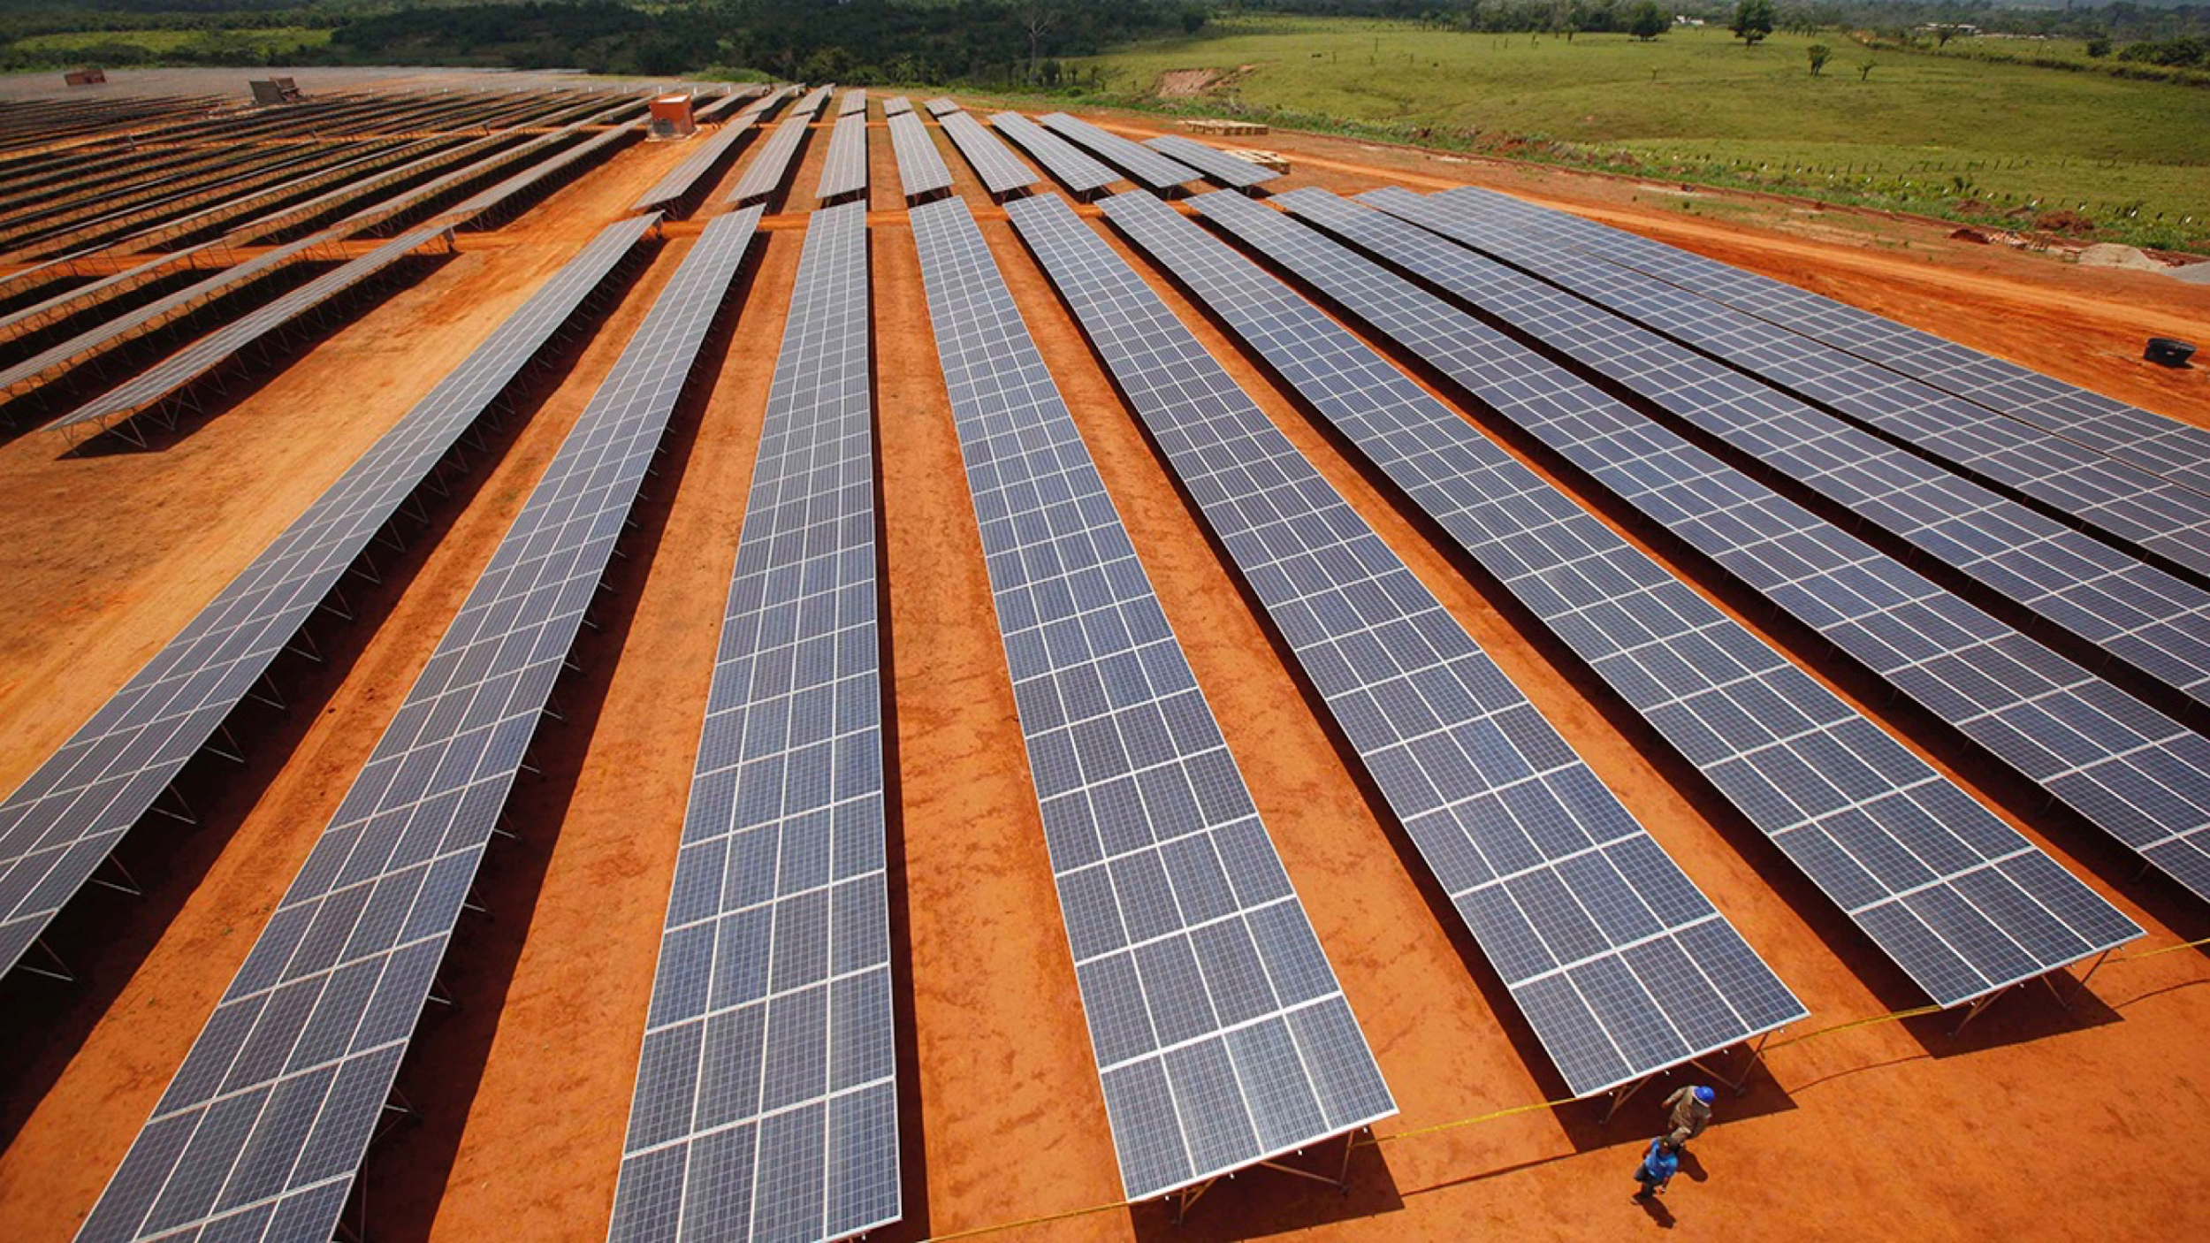
6. Learn more about joining an ECA Leadership Team
7. Contribute a Skill - write grant proposals, graphic design, produce newsletters, research, writing, administration, political advocacy, video production
8. Support ECA, Give a Gift Today. Make a tax-deductible contribution. Help keep our great work going!
9. Join our National Call! Get informed, inspired & engaged on our monthly call and hear what fellow climate advocates from across the country are doing.
10. Tell Your Friends and Family, and Help Us GROW!
For more info visit www.eldersclimateaction.org
or email us at info@eldersclimateaction.org
Help Us Build Brighter Future!

Slide 19
Find Us & Engage on Social Media!
Facebook: @eldersclimateaction
Twitter: @eldersclimate
YouTube: Elders Climate Action
www.eldersclimateaction.org

Slide 20
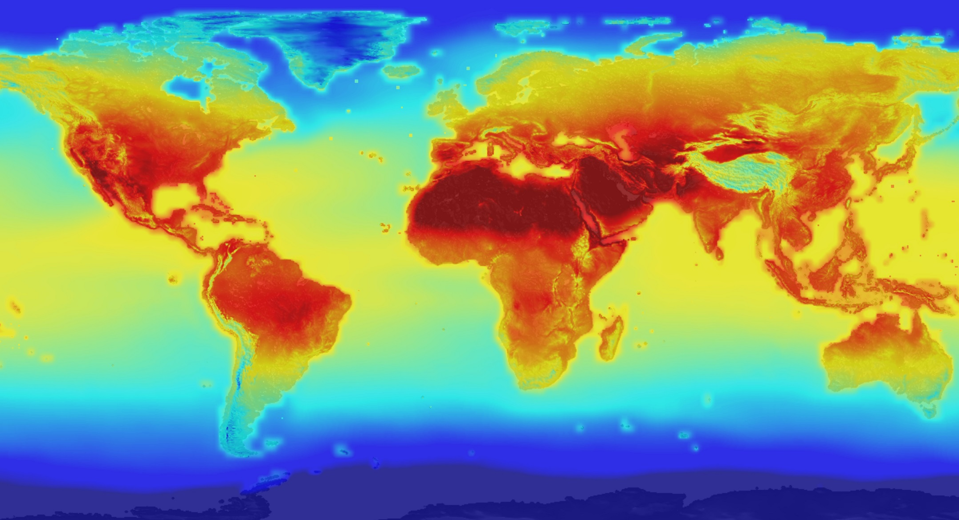
What Did You Do Once You Knew?

Slide 21
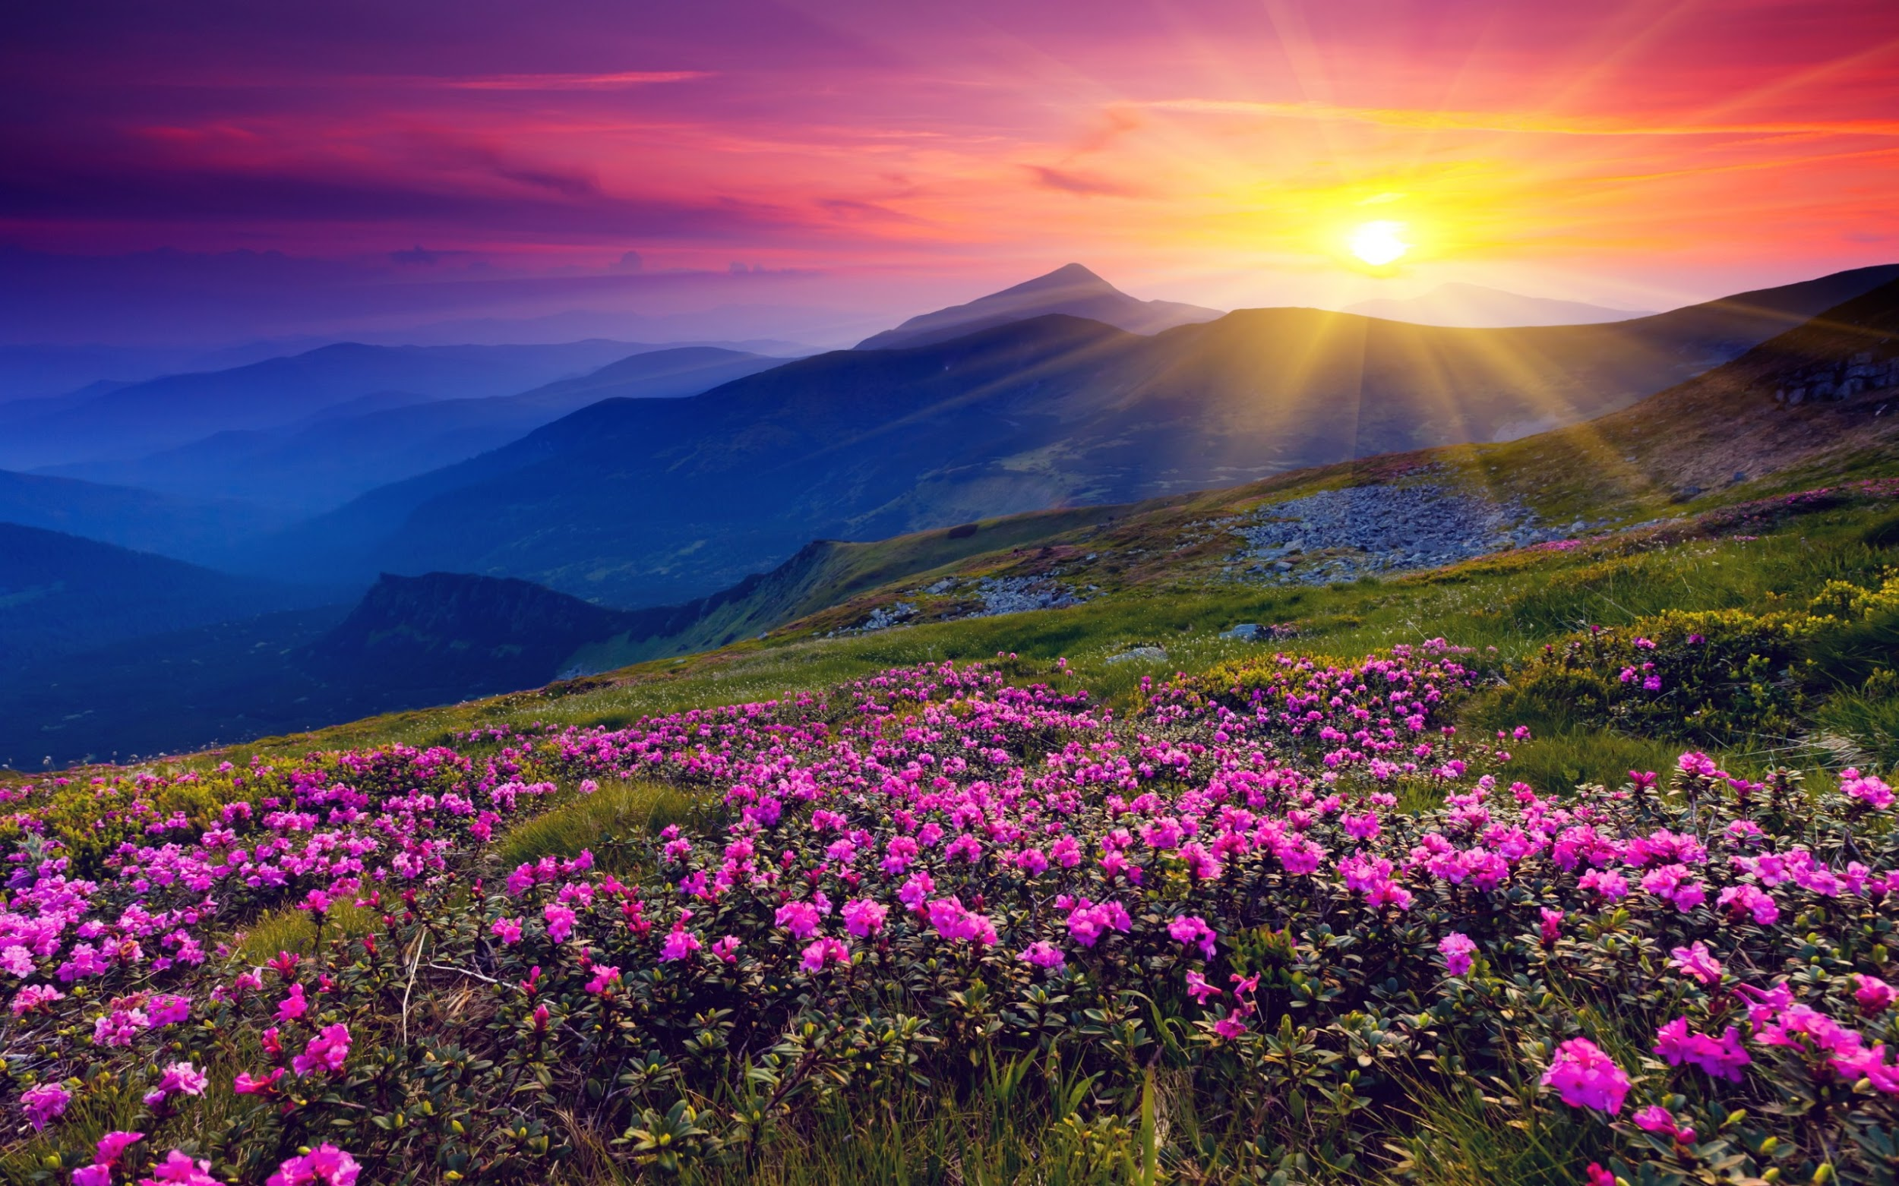
Thank You!
Together We Can Take Action on Climate Change!

